Slide 1


Gurugram
9th May,2017

Slide 2


1
MIT Brief History
Activity Standardization
2
3
DG Activity Planning
SA Best Practices
4
5
Process of Monitoring
Execution
Process of Performance
Review
6
Notes:
2

Slide 3
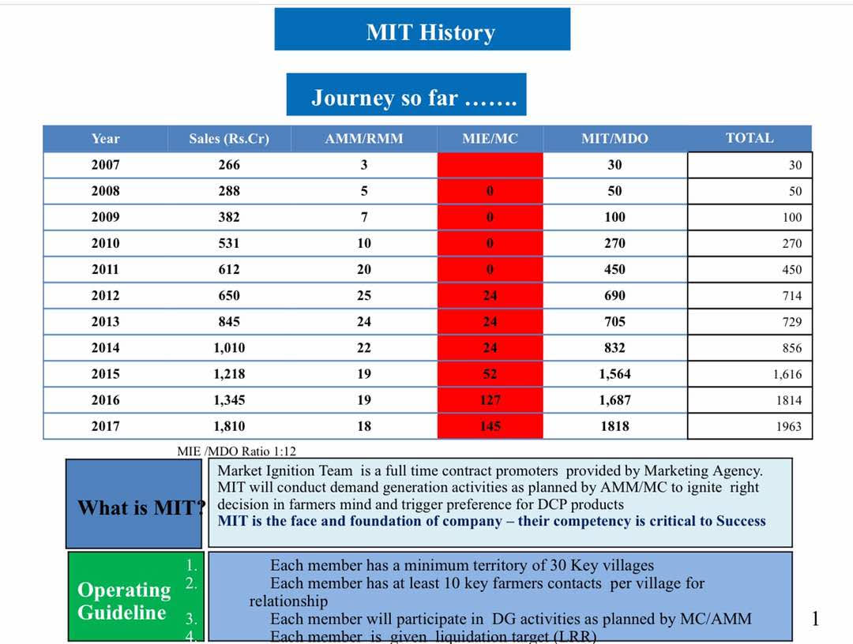
MIT Brief History

Slide 4

MIT Structure- SA
SD
MA
SIT
MIT
Sourcing
SIO
SIO
SIO
MIE
MIE
MC
ASM/RSM
AMM/RMM
BM
ZMM
RBM
MDM

Slide 5

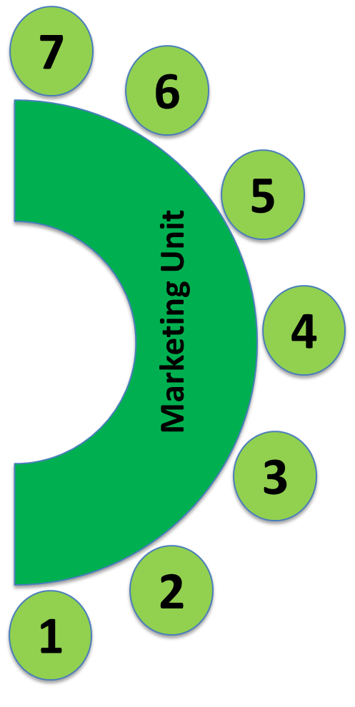




Territory & Resource Definitions
Marketing Unit is the smallest Unit of Planning for DG Activities in DCP SA, politically its same as the smallest unit on the map consisting of few villages(10-12 on an Average).
Each Marketing Development Officer handles number of Taluks depending on size in an radius of 50-60 Kilo Meters Radius
6-7 MDOs make 1 Sales Ignition Officer Territory, which is the basic revenue territory for DCP
2-3 SIOs territory make on Marketing Ignition Officer

Slide 6


Territory Planning
Product
Fit
Distribution
Opportunities
Resources
opportunities
Based on these criteria Territories are planned with an view on sustainable business in long term

Slide 7

Territory & Resource Planning Process
October
December
January
  MDM Plans Productivity Improvement Targets for each AMM Region
  Communicates Productivity Improvement Targets to AMM in October
Planning Meet
Discussion on Territory & Resources Planning and after broad alignment with leadership changes are made annually once in a calendar year
AMM discusses with MIEs and sales colleagues and plans for territory and productivity

Slide 8
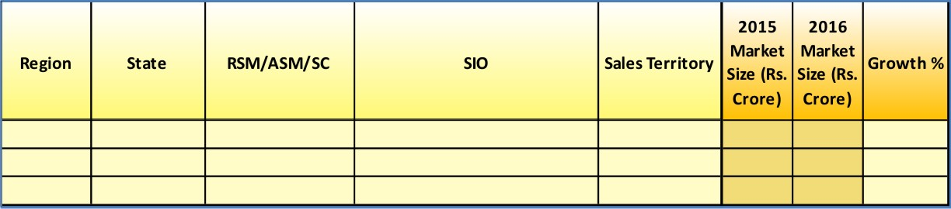

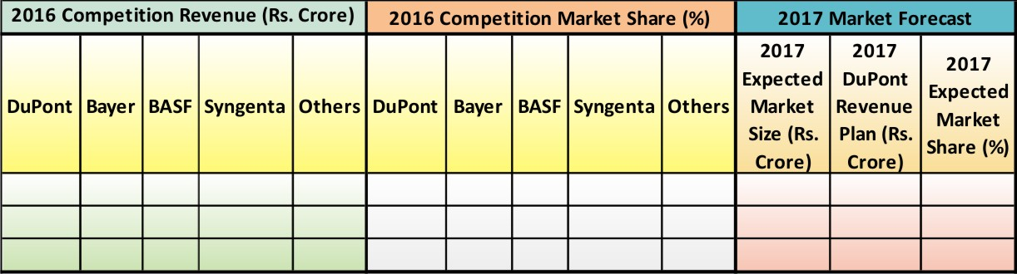
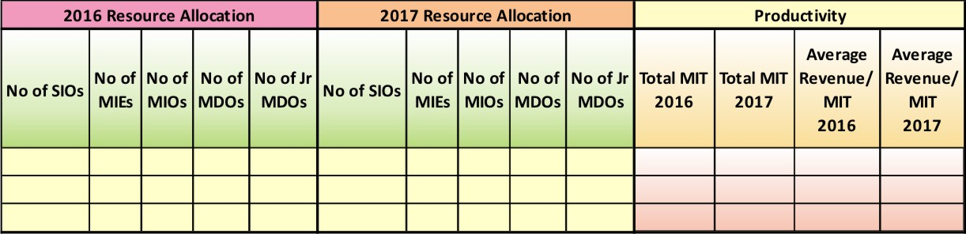
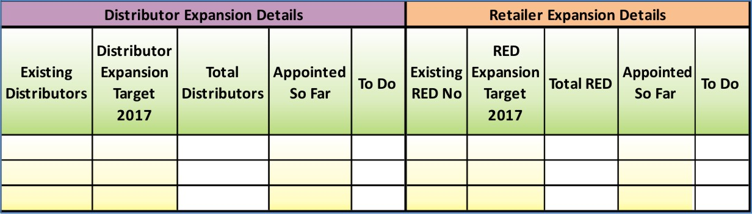
Territory & Resource Planning Tools
Market Growth Trends
Competition
Benchmarking
Resource Planning
Distribution Planning

Slide 9


Territory & Resource Planning Tools
Sales Territory Wise Man Power & Productivity Mapping
MM$/MIT
Sales Territory
Productivity
MIE Territory
Productivity
MM$/MIT
AMM/State
Productivity
MM$/MIT
Zone
Productivity
MM$/MIT
BU
Productivity
MM$/MIT

Slide 10

Differential Investments
Clear Mapping and Graphical Representation helps evaluating Productivity well across
There could be varied productivity levels across the AMM Regions depending on Developmental Stage of the business, at the initial stages it may be on a lower side where as ROI on developed markets would be much higher
Markets where we are near product AMP our Investments are different and where we need to ramp up to reach AMP investments are different.
Marketing Units based on their treated acreage levels are segregated in to New Markets, Developed Markets and clearly mapped for each AMM Region
Based on the Marketing Unit Segmentation we segregate them in to clear cut Segments and target them with specific DG Activities based on the goal for respective segments

Slide 11
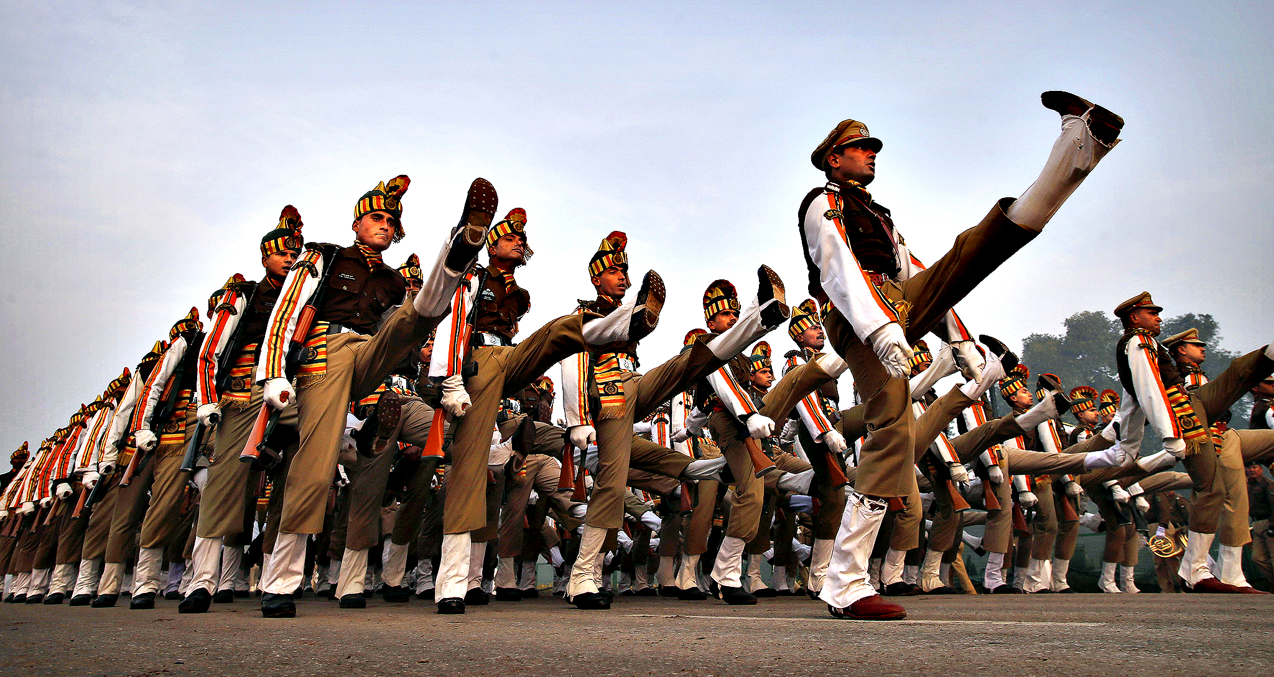
Getting the Best on the table and doing it the same way across is the winning combination of Innovations and Standardization for maximum results- This is the winning Mantra for MIT in SA

Slide 12
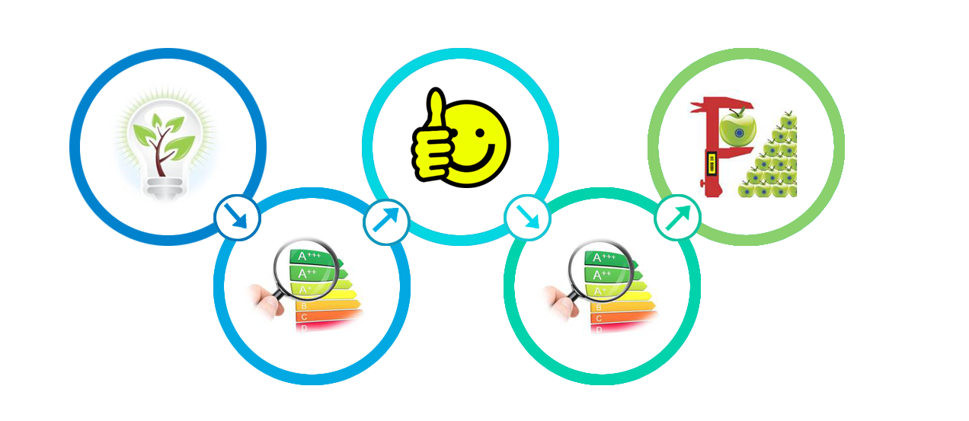

Activity Standardization Process
Objective :
To make sure that best practices are identified, replicated to adapt to local requirements and done similarly to conform to the guidelines across all markets
Standardization and Replication
Innovations
Pilot
Testing
Evaluation of Innovations by MIT Think Tank
Evaluation of Innovations by MIT Think Tank
MIT Think Tank is a platform for bringing in best practices done in some of the markets so that we can pilot the same and evaluate and adapt if the need be
This Process has helped us develop and standardize many key initiatives in DG Activities in south Asia.
Field on Wheel, Harvest Days, Early Field Days are few of them
Small add ons to the break through innovations are regularly updated by AMMs in their communication and rest others replicate those add ons in no time

Slide 13


DG Activity Planning
Y=f(nX1+nX2+nX3……+nXn)
Goal
What
What Activity to be undertaken Where ?
How Many is needed ?
When and How its going to be executed ?
How Many
1. What Activity to be undertaken Where ?
We have dedicated call centers with all regions where all MDOs share the farmer contacted data on a daily basis. 10% of this data is randomly called to take a feed back on their willingness to buy after attending the activity and which activity has motivated to buy the most.
Based on this we decide the activity type to be undertaken. It takes care the crop, market specific requirements.
Notes:
Who will decide what activity to be the key for each AMM area . Is it gut feeling ??
Ultimate customer decides as the business exists at the farmer and retailor interphase So we take feed back from the farmer

Slide 14
When and How its going to be executed ?
4 Months in advance preseason activity
4 Months in advance preseason activity
Additional Volumes to grow every crop season are
mapped from new and existing markets
Prospects and Key influencers are identified 4 months in advance
# 3 step Customer Engagement Program is followed

Slide 15
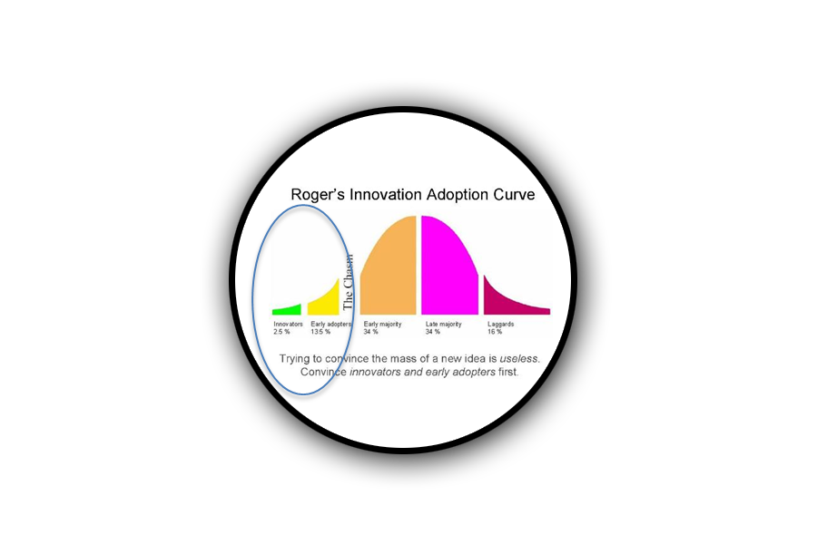


When and How its going to be executed ?
Village Mapping
New Village Selection – Before every season
Villages which are close to existing established market are selected
Criteria of serviceability by our MIT and Channel is considered
Farmer Profiling
Innovative Farmers are selected
whose land holding is more than the average
Whose per acre farm expenditure is more than average
Whose per acre yield is more than average
1st Level of contact by MIT in their respective villages
Innovative Farmer Identification(Avg 3-5 per village)
Potential Customers identification(Avg 20-50 per village
Engaging Farmers
Innovative Farmers are engaged in Multiplier Meetings
Potential Customers from each target village is engaged through HVC and our key farmers act as ambassadors for us
Covered in detailed
in next slides
Notes:
We visualize from which market my additional volume is going to come in current year
New village are identified
Can we go and contact every farmer of the village the answer is no
Key influencers to be identified for multiplyer form 100 mm

Slide 16
STP Approach for MIT in South Asia
5564 MU/Tehsils
5564
4904 MU/Tehsils
2877 MU/Tehsils
Putting Limited Resources to the Optimum Usage
Total Area
Total Segmented Area
Total Targeted Area

Slide 17
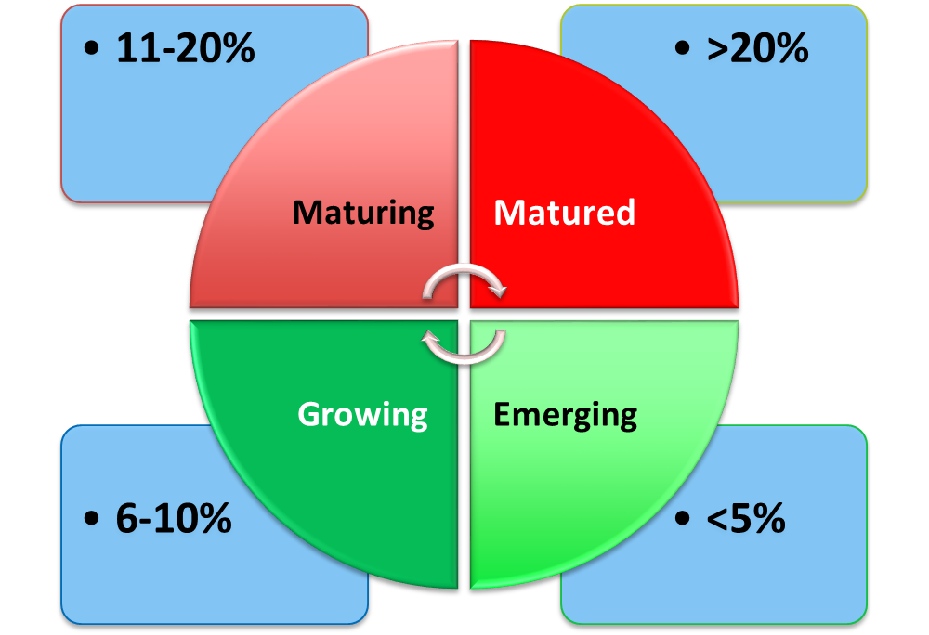
What Activity to be undertaken Where ?
How we do it ?
Example :West Bengal Boro ( Early Summer Season)
We have AMP(Available Market Potential) for Ferterra in WB is estimated @30%
In Boro 2016 we have 19% treated acreage
While Planning for 2017 Boro season we DE bundle the average and segregate the treated acreage in different markets
Our approach would be different for different markets
Key Segments | Objective | Differential Approach | Key Activities
Matured Markets | Sustain | Focus on Brand Recall through mass advertisement/media approach | Hoardings, Wall Paintings, Bus Panels, ATL
Maturing Markets | Consolidate | Focus on extensive Brand Promotion Drive | ATL, High Voltage & Branded Van Campaigns
Growing Markets | Grow | Brand Awareness Drive & Focus on improved Value realization | Testimonials, PDAs, Key Influencer Engagements
Emerging Markets | Establish | Product Differentiation Activities | Demos, Field Days, Harvest Days

Slide 18
Differential Demand Creation Approach
Key Objective :
Increase touch base
Optimize spends
Increase effectiveness of DGAs
Establishing MU | Growing MU | Maturing MU | Matured MU
Key Segments | Differential Approach
Matured Markets | Focus on Brand Recall through mass advertisement/ media approach
Maturing Markets | Focus on extensive Brand Promotion Drive
Growing Markets | Brand Awareness Drive & Focus on improved Value realization
Establishing Markets | Product Differentiation Activities
Area Available | % Treated Area | Target Treated % for the MU | Volumes Planned | Investment Planned

Slide 19
DG Activity Planning
Campaign phase | Objectives | Prioritized Activities
Pre Season | Demonstrating Value of products Enagage users Contact non users Trigger decisions | One to One interactions Farmer Meetings Early Season Field days Harvest days
On Season | Trigger usage | Field on Wheels Mass Campaigns- BVCs/HVCs
Post Season | Demonstrating Value of products Collect feedback | Collect Testimonials, Build Grower Database Channel Engagement & Grower Linkages

Slide 20
DG Activity Planning
Regular/Early Field Days
Value Communicating Activities
Individual Contact
Group Meeting – Small Unorganized, Medium/Large Organized, Multiplier, Product Launch Meeting
Brand Recall Activities
Lamp Postering
Point of Purchase Branding
Harvest Days
ATL (TV/Radio Ad)
Crop Seminars
Tray Pe Charcha & FoW
Product Demo
Value Demonstrating Activities
70%
20%
10%
Investment

Slide 21
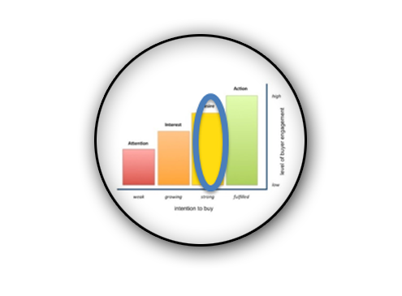
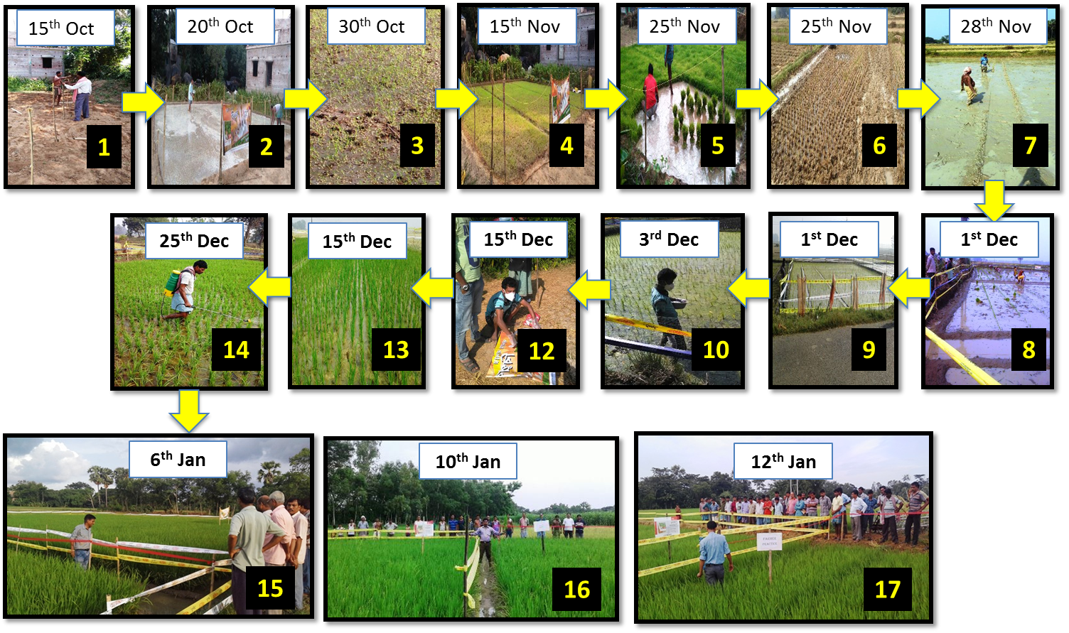

DuPont Portfolio Early Field Day
3 Months in advance preparations for this activity starts
One DuPont Portfolio EFD caters to at least 30 villages and 300 to 500 innovative farmers
No Leasing Cost for the land, No Farming Cost is given to farmer, Only Cost is the cost of Demo
Low cost model helps us to replicate it across
Specific Seed Varieties are selected for early farming
Innovative Farmers who are interested to be in the high light come forward to volunteer
This activity helps us to engage the farmers in the off season when they are able to participate freely and staff is also able to do it more focus as he has not much liquidation pressure during this time

Slide 22
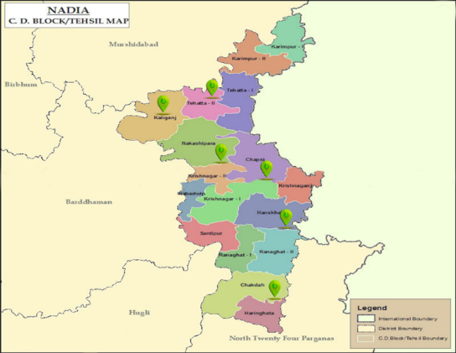
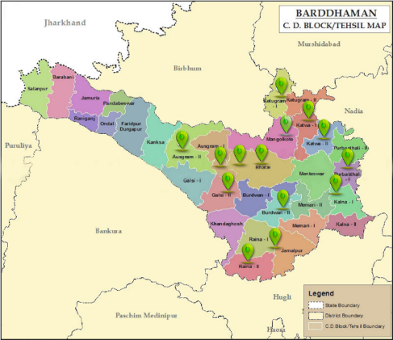
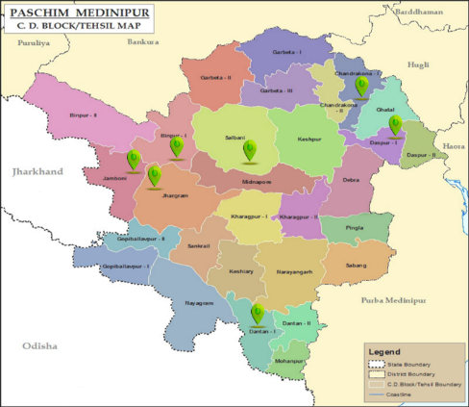
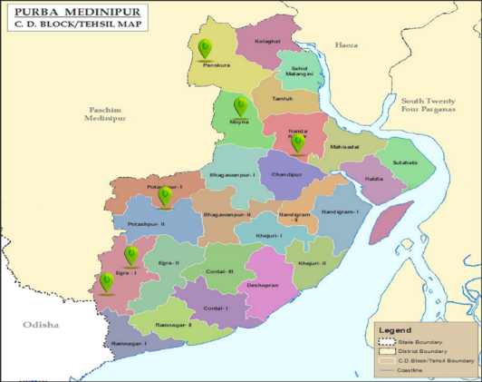

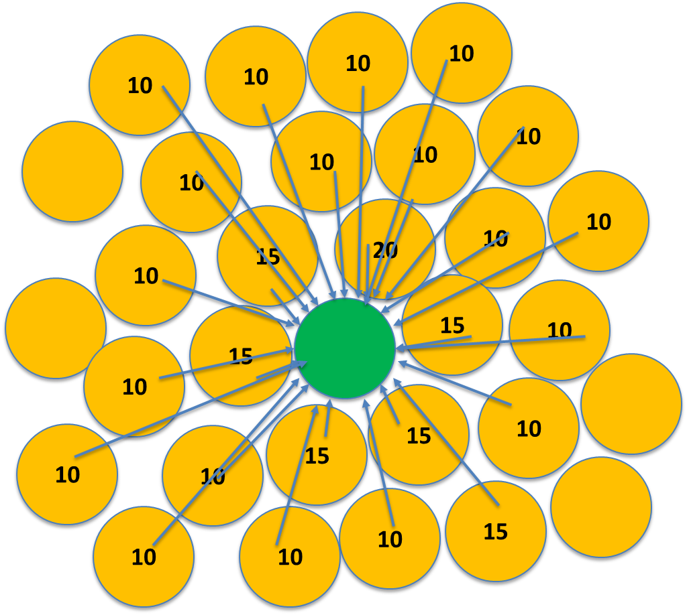
DuPont Portfolio Early Field Day
3 Months in advance preparations for this activity starts
Village Selection and Farmer Selection is done
All New Markets bellow the state treated acreage is selected for this activity
All Farmers who are selected are taken to the plots
Such approach helps is visualize what we are doing in which area

Slide 23
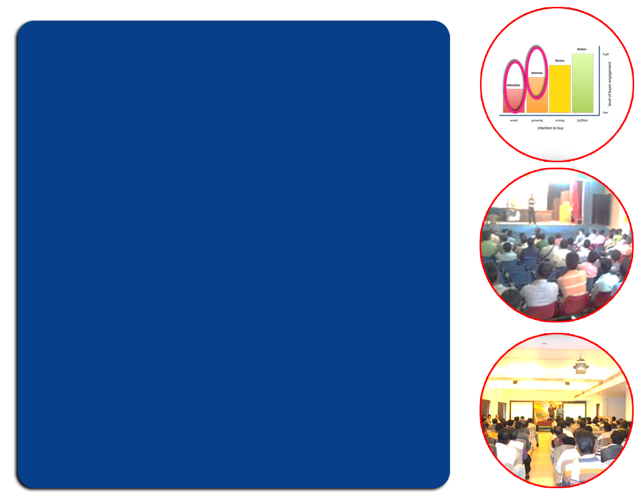
Multiplier Meet(LFM)
Multiplier Meets are used generally in areas where awareness level is low. Brand Awareness could be there but detailed awareness on Product Features, Benefits are not known
Primarily used as a tool to bring attention among selected key influencers of more than 25-30 villages.
Helps in reaching out to bigger area in lesser time
The farmers who participate in these meeting are key opinion makers in their respective villages
We continuously follow up these prospects so that once they start using their followers immediately follow suit which requires our less efforts
We invite farmers with special invitation card
These meetings are conducted in the meeting hall/ Tents at a place out of their villages, this helps us avoiding any unwanted crowd
We do this while introducing new products or existing products in new markets

Slide 24
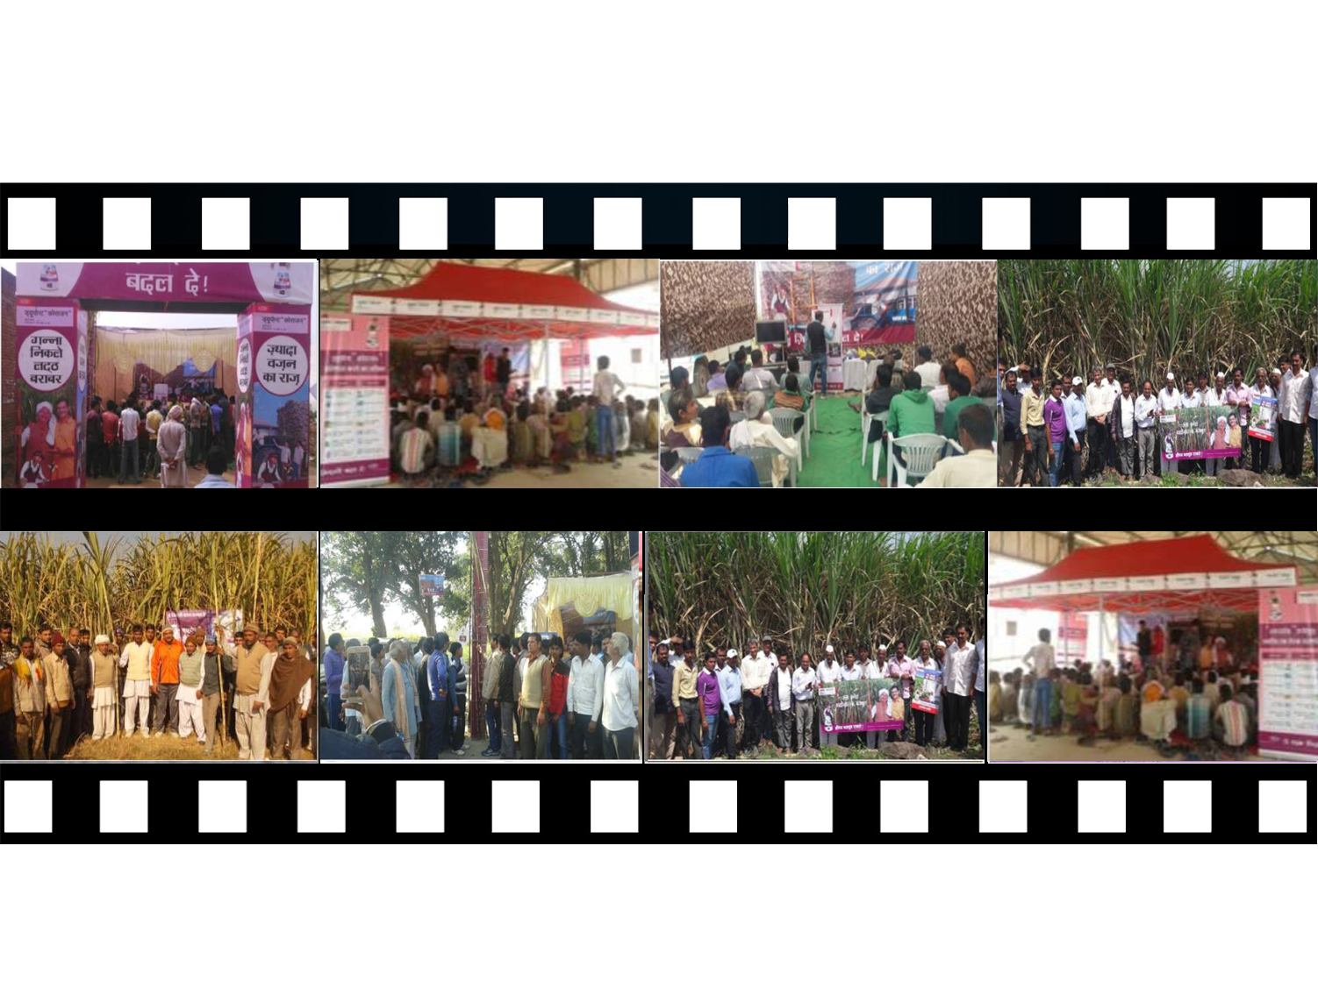

Harvest Days-Sugarcane

Slide 25
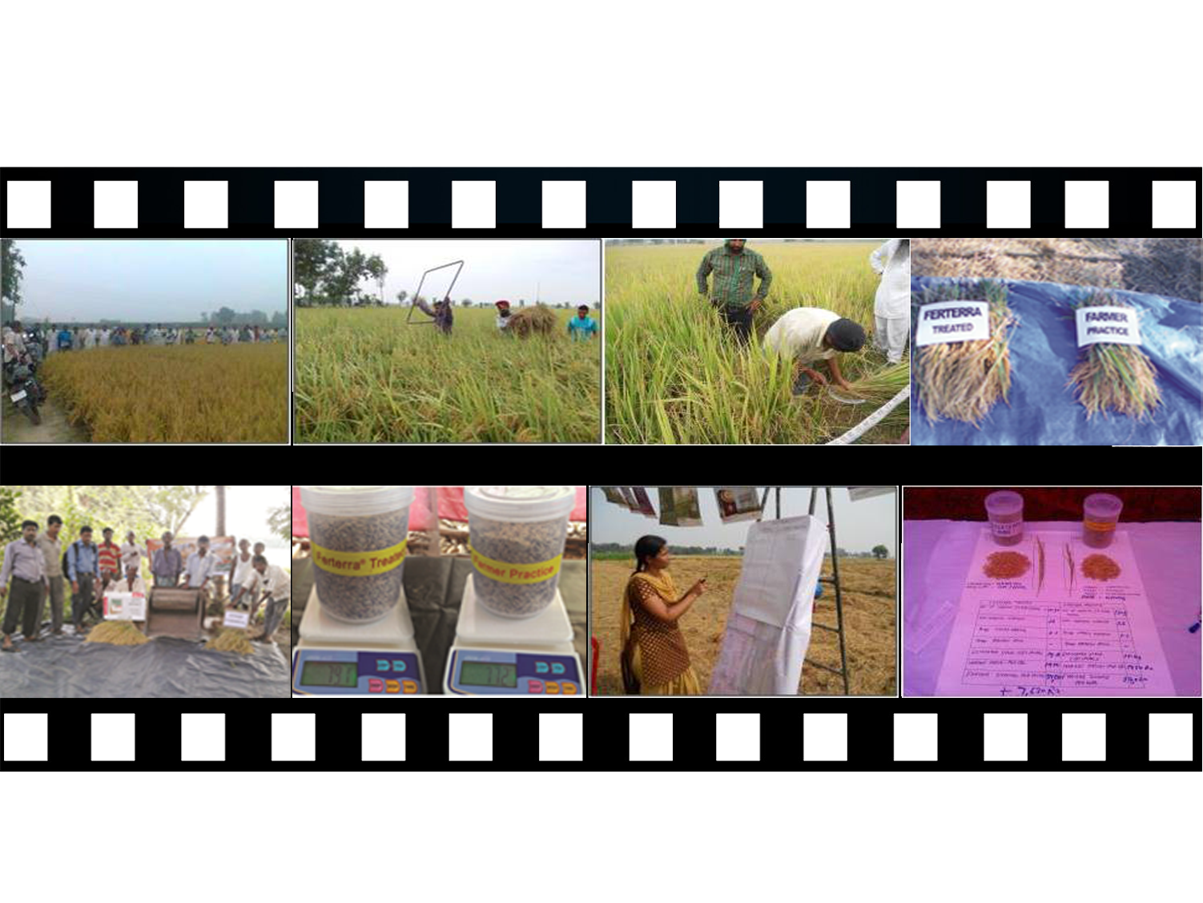

Harvest Day in Paddy

Slide 26
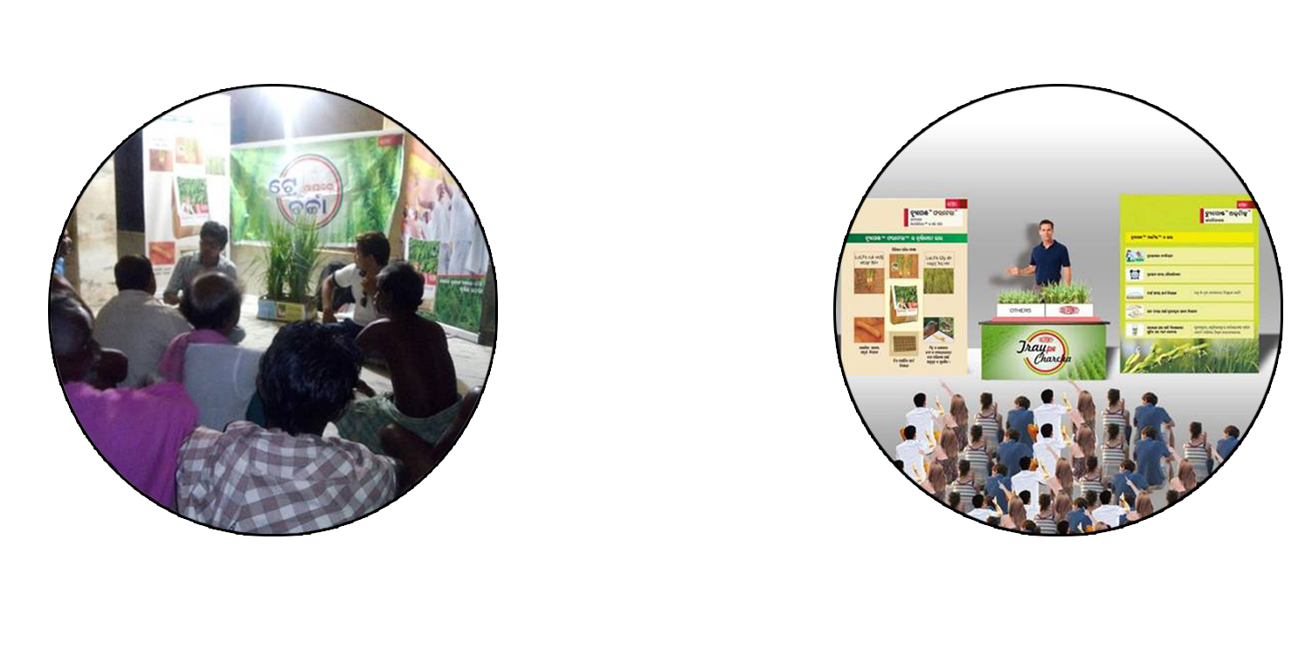

Tray pe Charcha
Tray Pe Charcha Concept
Tray Pe Charcha in Action
User Farmers Speak in front of Non Users and MIT Team coordinate in the meeting, it takes place in front of Retailer Counters to convert awareness in to sales
This is a campaign where RED Club Retailers are involved with MIT activities for better conversion
Special care is taken to select retailers who will take good care of trays

Slide 27



DG Activity Planning
1.Face to Face interactions
2. Big & Key growers, Ambassadors,
PURPOSE : Brand recall, reinforcements, endorsements.
Contacts
Pre-Season - 60-70%
On-season - 30-40%
Group
Meetings
1.Massive contacts
2.Group of 8-10 farmers
PURPOSE : Brings connect with non users.
Pre-Season - 60-70%
On-season - 30-40%
Large Farmer
Meetings
1.Targeted growers, Massive contacts
2.Targeted group of 75-100 farmers
PURPOSE : Brings connect with non users.
Pre-Season - 70-80%
On-season - 20-30%
Notes:
Each Activity is defined as to when it is to be done and why it is to be done

Slide 28

DG Activity Planning
1.Demonstrate product superiority
2.Meets farmers ‘ needs, overcomes
concern
PURPOSE : triggers decision making and preference to our brands.
Product
Demos
On-season - 100%
1.Highlight product superiority, differentiators
in terms of KPIs & KPMs and other value
differentiators
2.Provide superior value & benefits
PURPOSE : Builds confidence among farmers.
Early
Field Visits
Pre-season - 100%
1.Massive contacts
2.Targeted market/crop/period
PURPOSE : Brand Reinforcement,
Brings connect with non users.
Campaigns-
HVC/BVC
Pre-Season - 20-30%
On-season - 70-80%

Slide 29
DG Activity Planning
1.Highlight yield difference, quality aspects
2.Show superior value & benefits
.PURPOSE: Triggers preference to our brands
Pre -season - 100%
East & South)
Post Season – 100%
North
Harvest Days
1.Key Farmers, Opinion Leaders
2.Scientists, Policy makers, Dept Officials
PURPOSE :.Helps to get endorsement
Pre -Season
On - Season
Post- Season
Key Influencers
Engagement
1.Print media
2.Cable TV Ads
3.Agri Exhibitions
PURPOSE:.Brand reinforcement,
Connect with Users.
Mass Media
Campaigns
Pre-Season - 50%
On-season - 50%

Slide 30
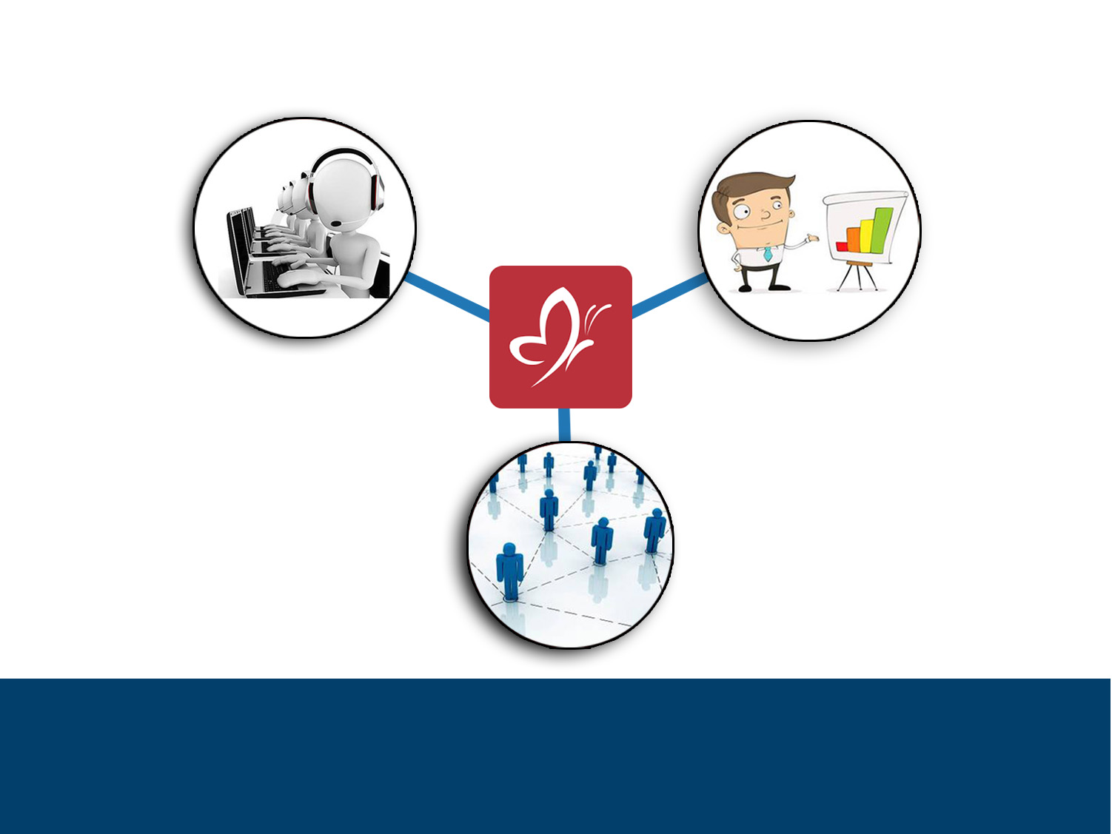
Process of Monitoring Execution
Activity Efficiency & Conversion Review-Daily and Weekly Report Submission
Activity Submission Daily
Activity Plan- Monthly
Activity Submission Daily
Based on the Activity Conversion and Efficiency AMM take a call on targeted training and development for the team
Follow Up the areas where activity needs to be developed
Weekly Review Happens every Saturday by AMM , Call Center gives report to AMM on every Friday. AMM shares the review report with DGM and ZMM every Monday during liquidation review and MBM every month beginning with DGM Market Ignition .on Liquidation review and Liquidation forecast
Weekly review and Monthly review helps to get lead indicators for taking any corrective measure if required.
Notes:
So many activities ??
Big country ,Diverse geography, different languages …… its impossible to run the show without proper controls in place
AMM prepares annual activity calendar . But he share only monthly activity plans with the MIE’s and MIE’S in turn communicate only the weekly activity plan to the MDO
Metamorph gives only the quantity party of the activity . But quantity is not everything Quantity is imp but quality is even more imp

Slide 31



Process of Performance Review
Activity & Liquidation Plan
Performance Measurement Metrics
Forecast Accuracy of Liquidation LRR
Forecast accuracy for Activity Planning
% Liquidation of Crop PO/Revenue PO
Monthly MBM by MDM
Activity & Liquidation Achievement
Calendar Shared at the beginning of the year
Dates & Venue fixed for entire year
Submission of review data formats are standardized with standard agenda
Activity & Liquidation Plan
Activity & Liquidation Achievement
Monthly MIE- MDO MBM by AMM
Activity & Liquidation Plan
Activity & Liquidation Achievement

Slide 32
Performance Measurement Metrics
LRR- liquidation Run Rate
Liquidation Forecasting
Forecast Accuracy of Liquidation LRR
Forecast accuracy for Activity Planning
% Liquidation of Crop PO/Revenue PO

Slide 33


